Slide 1

Workshop on R Programming
Md. Ahsanul Islam
Former President, Programming Club
Department of Statistics, University of Chittagong
5 April 2024 – 6 April 2024

Slide 2

About Me
Freelancer in Data Analysis Sector
Former president of the Programming Club, Department of Statistics, University of Chittagong
Former executive at Luminaries Research Ltd.
Education
Bachelor of Science (Hons.) in Statistics, University of Chittagong
Master of Science (Thesis) in Statistics, University of Chittagong (ongoing)
Linkedin | Facebook | GitHub | Website

Slide 3
Things you will learn:
Basics of R programming
RStudio IDE
Data Import, and export
Data Wrangling (using base R, tidyverse, and more)
Data Visualization (using ggplot2, and more)
Data Summarization and Modeling

Slide 4
Requirements
No prior programming experience required.
Any educational background.
Laptop or desktop computer.
Access to the internet.

Slide 5
Workshop materials include:
R scripts
Datasets
Slides
Cheat Sheets: https://posit.co/resources/cheatsheets/
Available at: https://github.com/MdAhsanulHimel/workshop_r_programming_cuss/

Slide 6
A brief history of R Programming
In 1992, the R‐project was started by Ross Ihaka and Robert Gentleman at the University of Auckland, New Zealand.
On 2000-02-29, the first official 1.0 version of R was released.
In 1997, the Comprehensive R Archive Network (CRAN) was established.
In September 2011, RStudio was initially launched, and in 2016 it got its first major release.
In November 2012, RStudio (current Posit) released shiny, a framework for developing web applications.
In 2016, Hadley Wickham and his team at RStudio released tidyverse (a set of packages).
The latest R version 4.3.3 (Angel Food Cake) has been released on 2024-02-29.

Slide 7

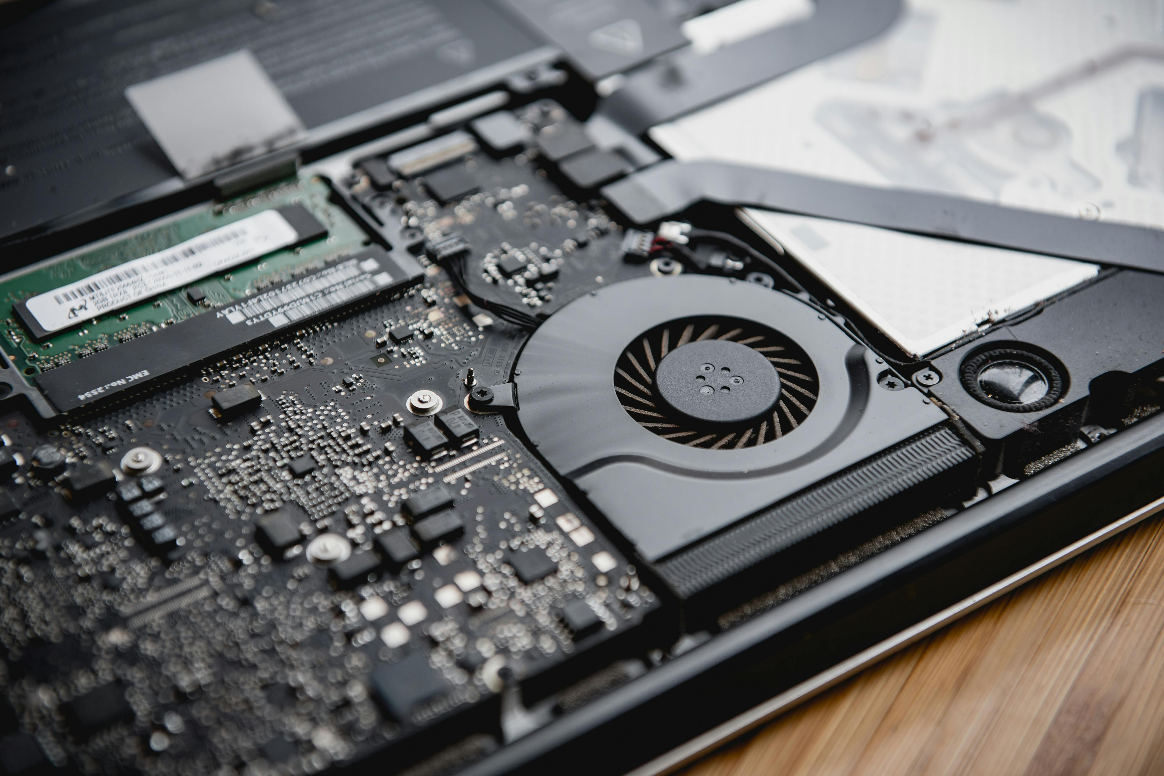

Why RStudio IDE (Integrated Development Environment)?
Backend
Frontend

Slide 8
Other IDEs (Integrated Development Environments)
VSCode
Jupyter Notebook
Atom
Sublime Text
And many more

Slide 9
Usual Analysis Workflow in R
Summarization
Hypothesis Testing
Import Data
Perform Data Wrangling
Data Visualization
Statistical Analysis
Reporting
Modeling
Machine Learning

Slide 10
Summarization
Hypothesis Testing
Import Data
Perform Data Wrangling
Data Visualization
Statistical Analysis
Reporting
Modeling
Machine Learning
Some of the most common file types include:
CSV (comma separated values)
Excel
SPSS
STATA

Slide 11
Summarization
Hypothesis Testing
Import Data
Perform Data Wrangling
Data Visualization
Statistical Analysis
Reporting
Modeling
Machine Learning
Two different ways:
Base R
Tidyverse

Slide 12
Summarization
Hypothesis Testing
Import Data
Perform Data Wrangling
Data Visualization
Statistical Analysis
Reporting
Modeling
Machine Learning
Base R
ggplot2
plotly
leaflet
And many more

Slide 13
Summarization
Hypothesis Testing
Import Data
Perform Data Wrangling
Data Visualization
Statistical Analysis
Reporting
Modeling
Machine Learning
A couldn’t dare to list anything in this slide.

Slide 14
PDF from rmarkdown
Word file from rmarkdown
HTML file from rmarkdown
Publish to rpubs.com
R Shiny Webapp
Flexdashboard
Slide from xarigan
Summarization
Hypothesis Testing
Import Data
Perform Data Wrangling
Data Visualization
Statistical Analysis
Reporting
Modeling
Machine Learning

Slide 15
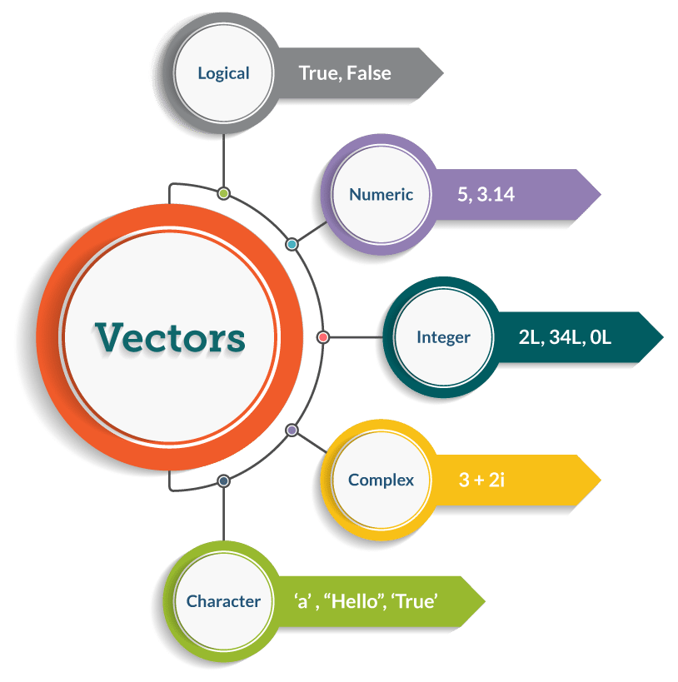
Data Types
Image: Edureka
Notes:
Credit: Edureka

Slide 16
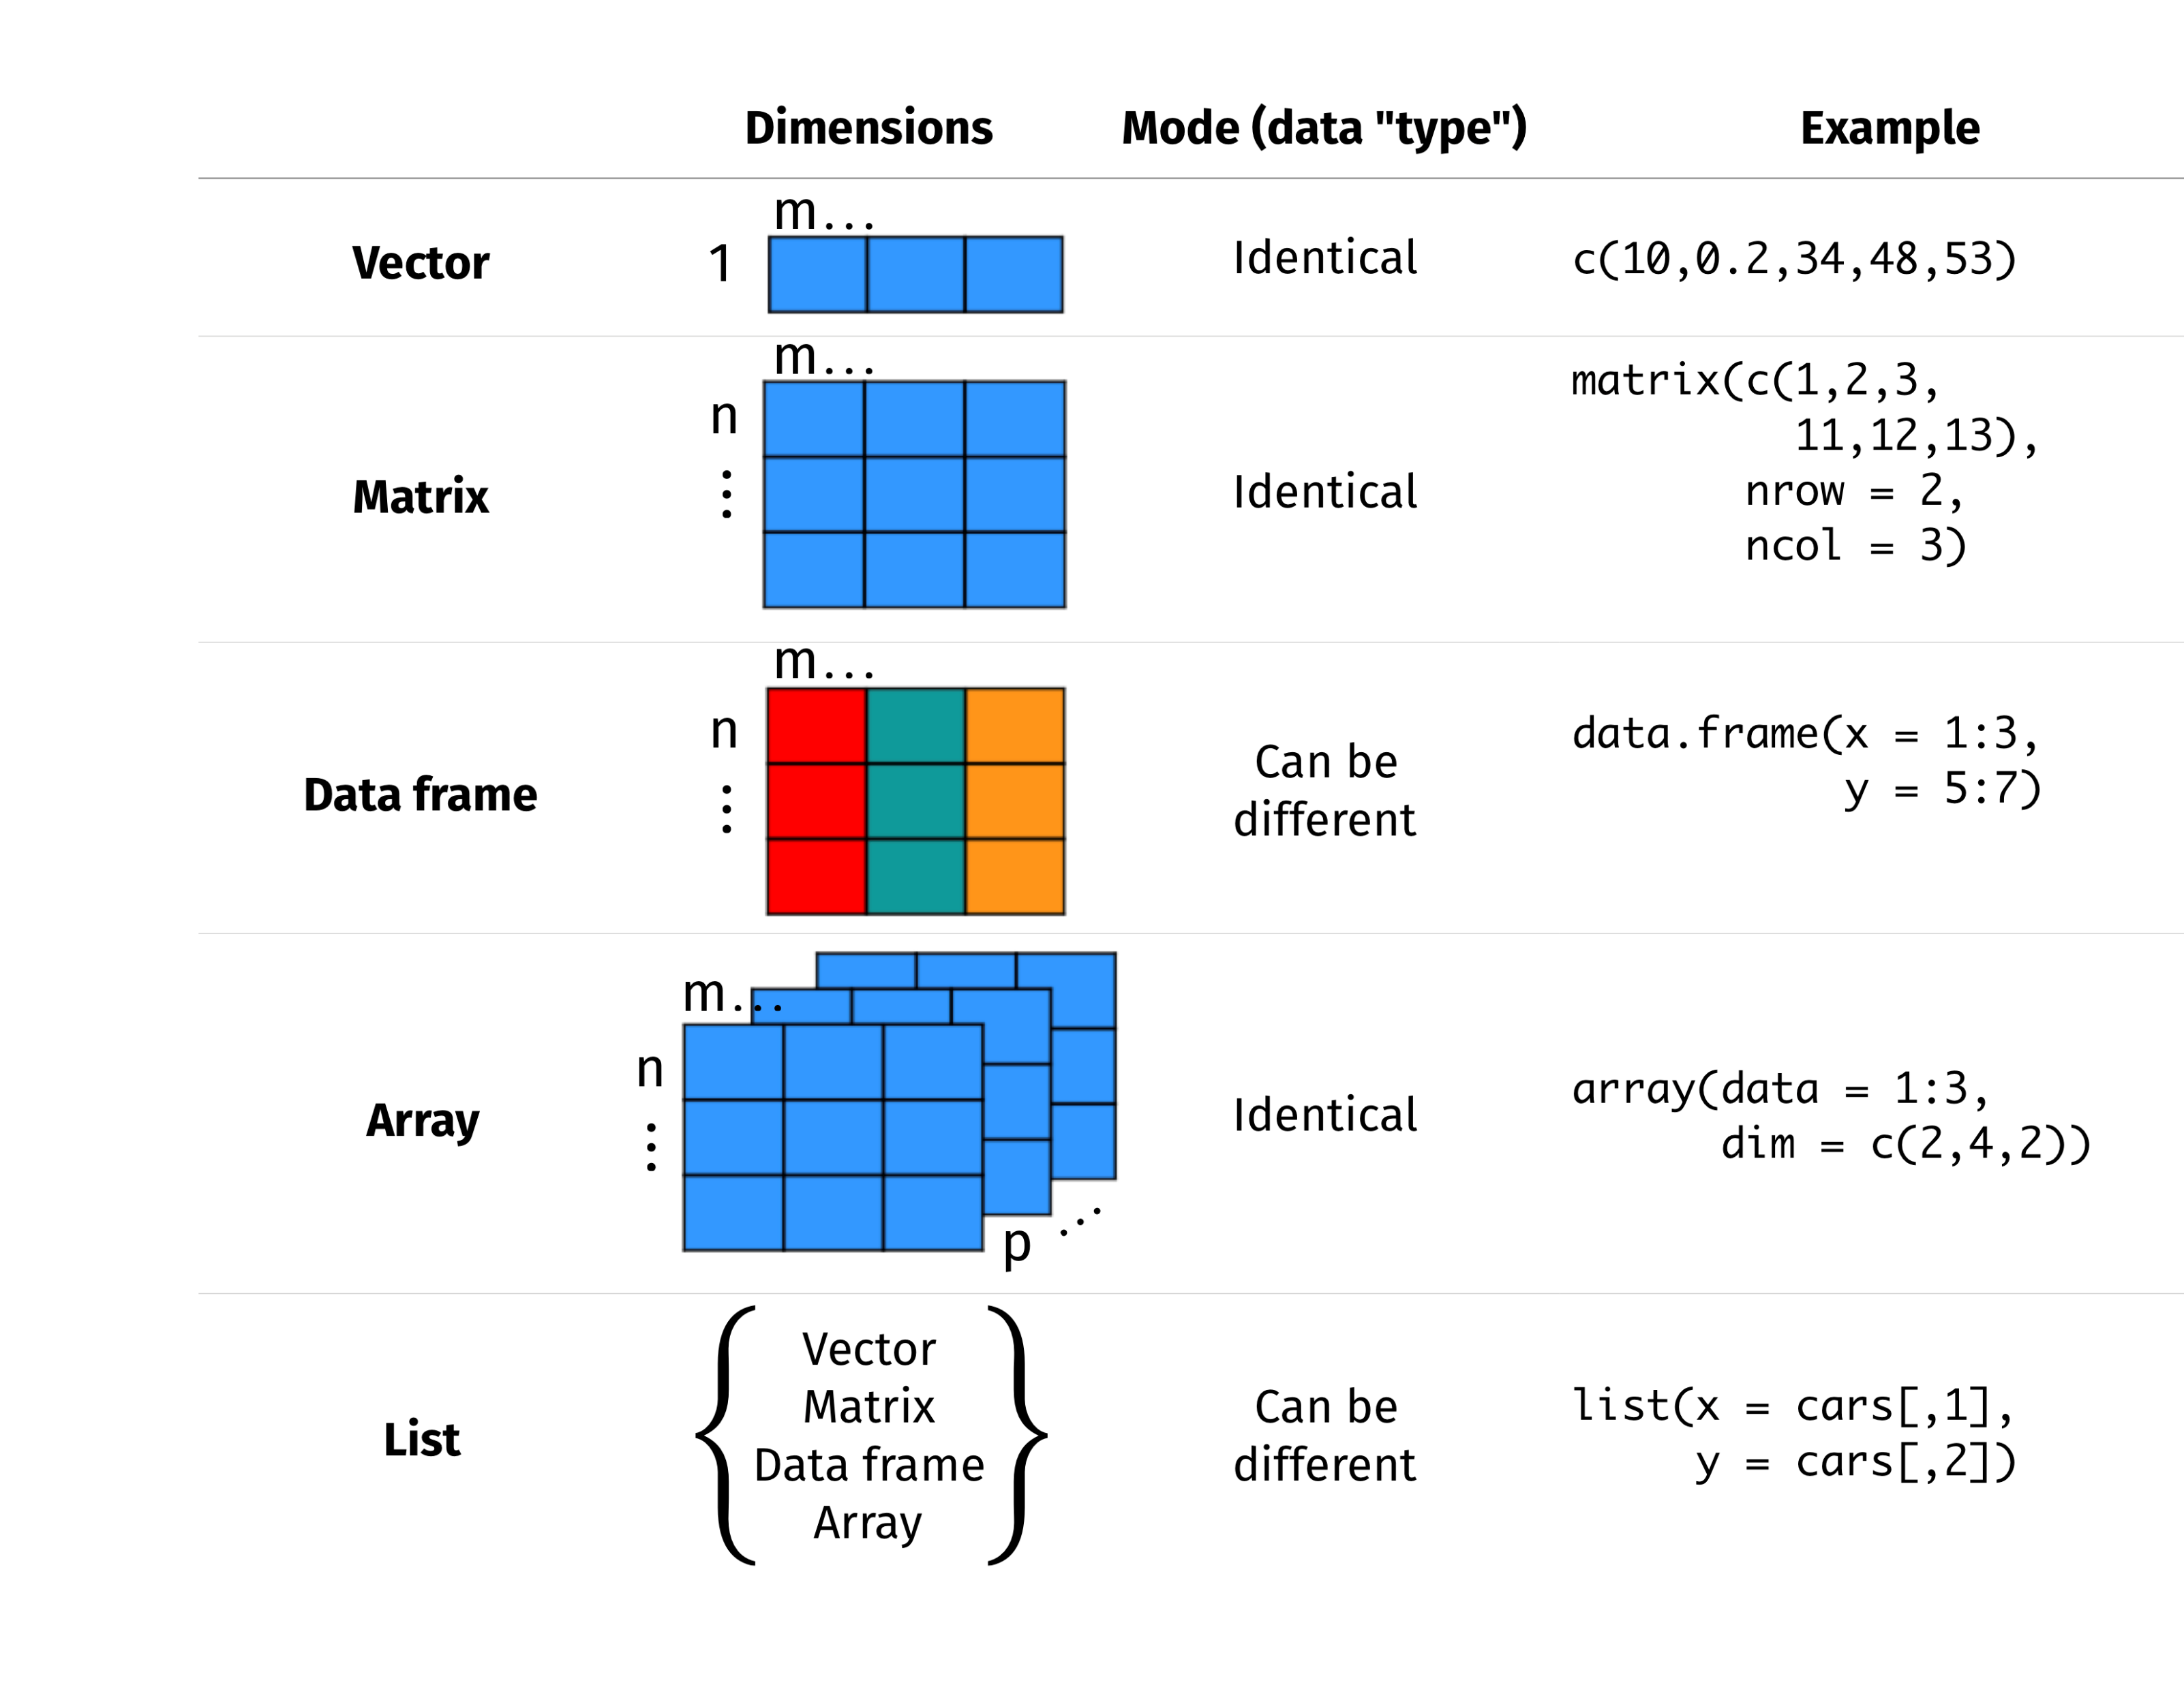
Data Structures
Image: Québec Centre for Biodiversity Science

Slide 17
Testing with Logical Operators
< and > “less than” and “greater than”
<= and => “less than or equal to” and “greater than or equal to”
== “equal to”
!= “not equal to”
| “or”
& “and”
%in% “inside”

Slide 18
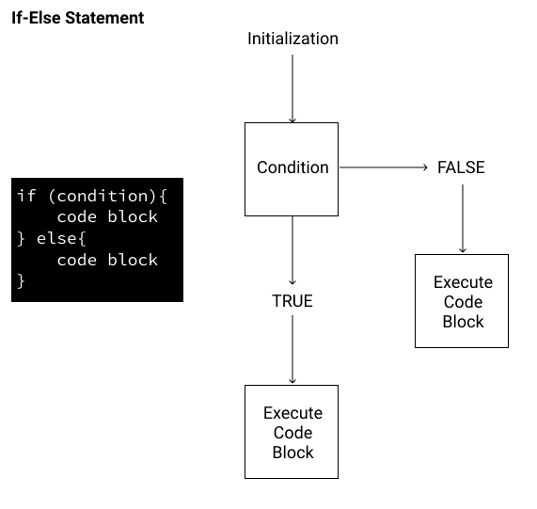
Control Flow
Image: Dataquest

Slide 19
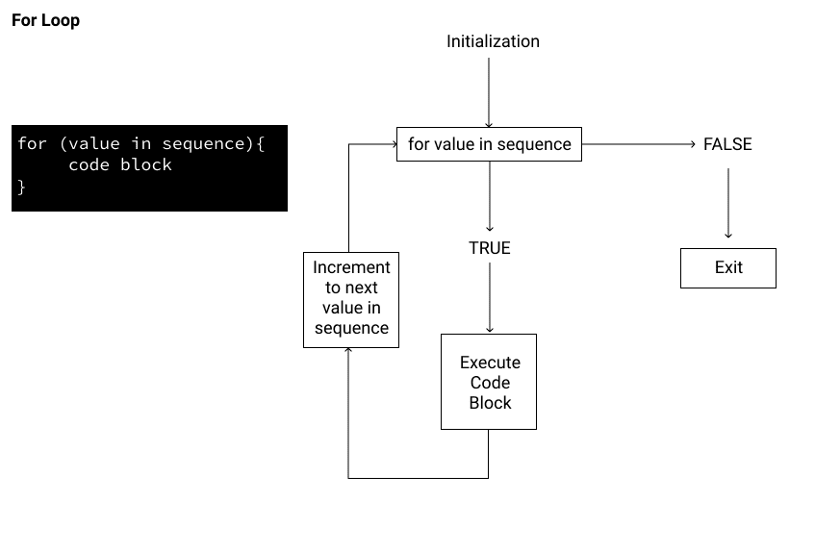
Iteration
Image: Dataquest

Slide 20
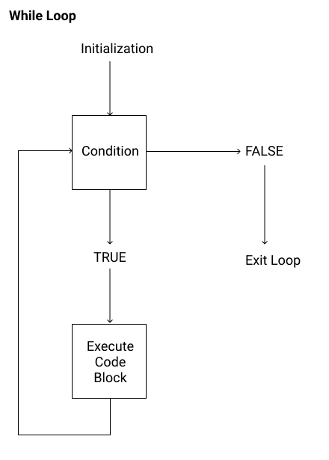
Iteration
Image: Dataquest

Slide 21
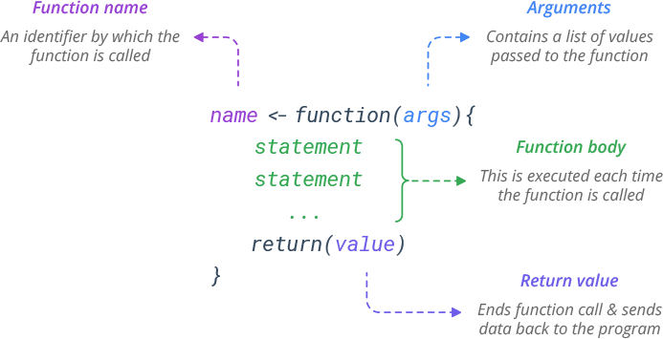
Function
Image: Betsi Santos

Slide 22
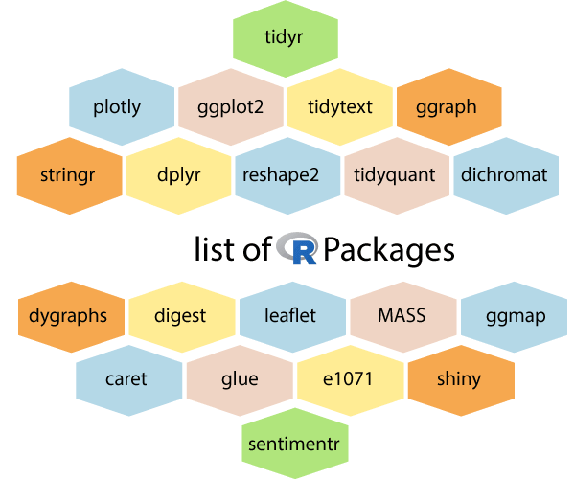
Package
As of 2 April 2024, the CRAN package repository features 20,655 packages.
See more: https://cran.r-project.org/web/packages/
install.packages() to install packages from CRAN.
devtools::install_github() to install packages from Github.

Slide 23
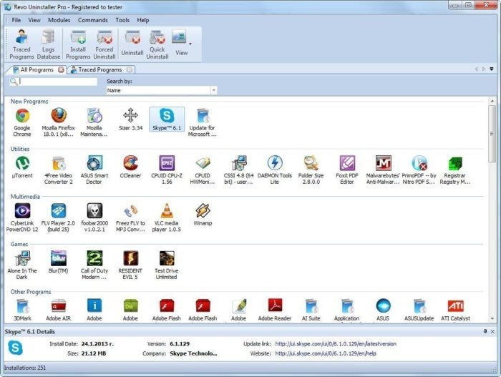
Why Packages?
You have laptop
You install software
You have R
You install packages

Slide 24
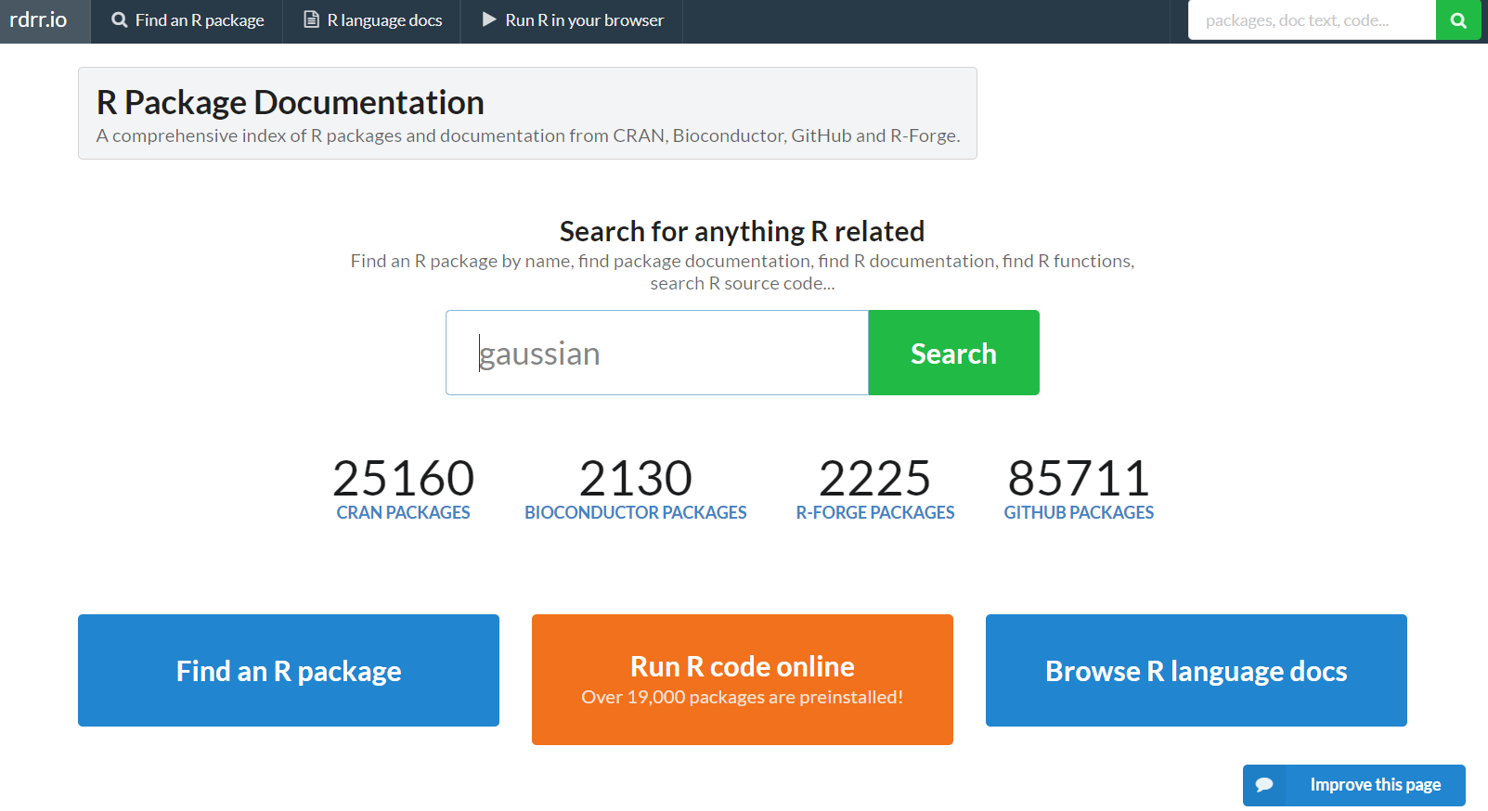
Package
https://rdrr.io/

Slide 25
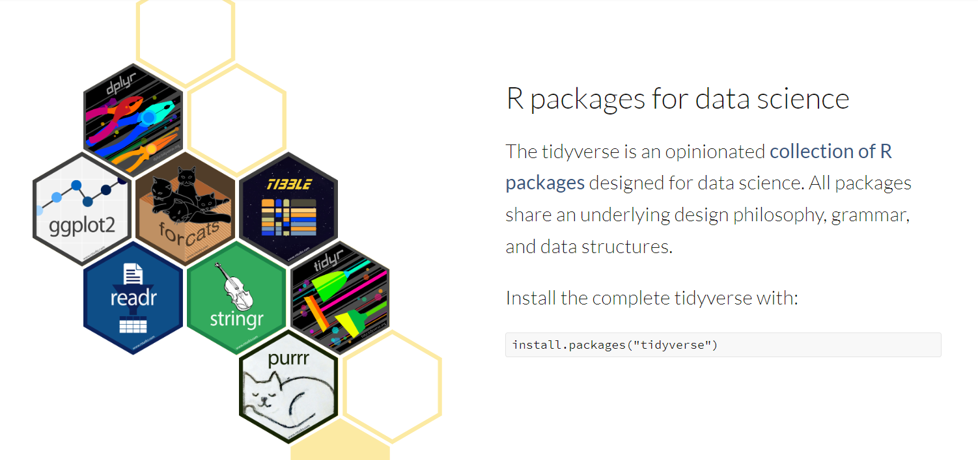
tidyverse

Slide 26
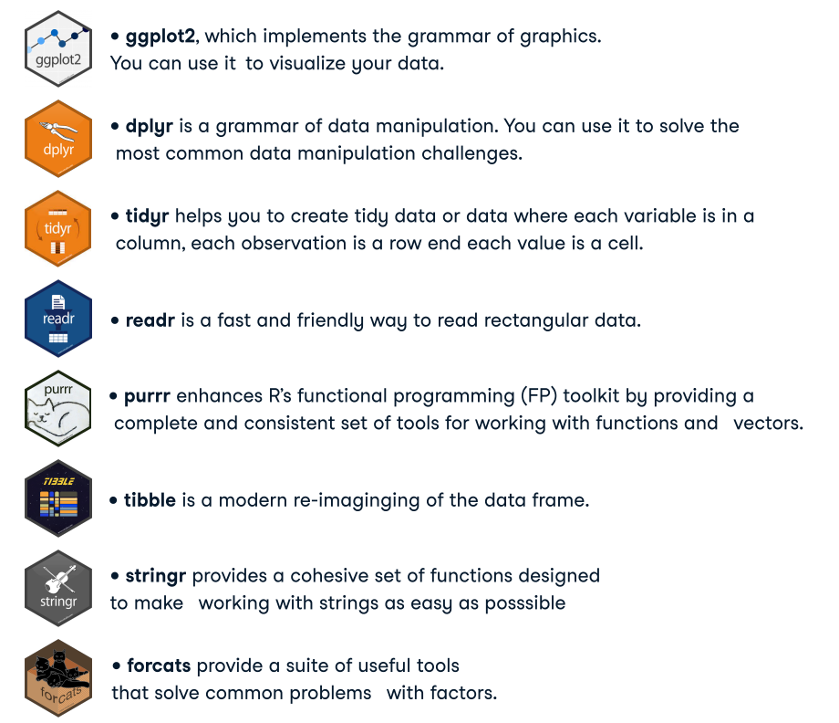
Core Packages in tidyverse

Slide 27
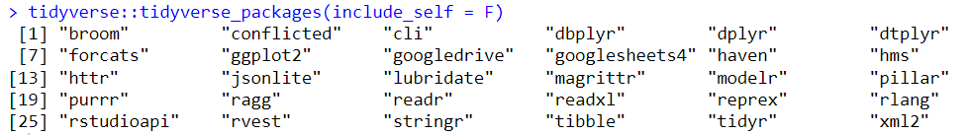
All packages in tidyverse

Slide 28
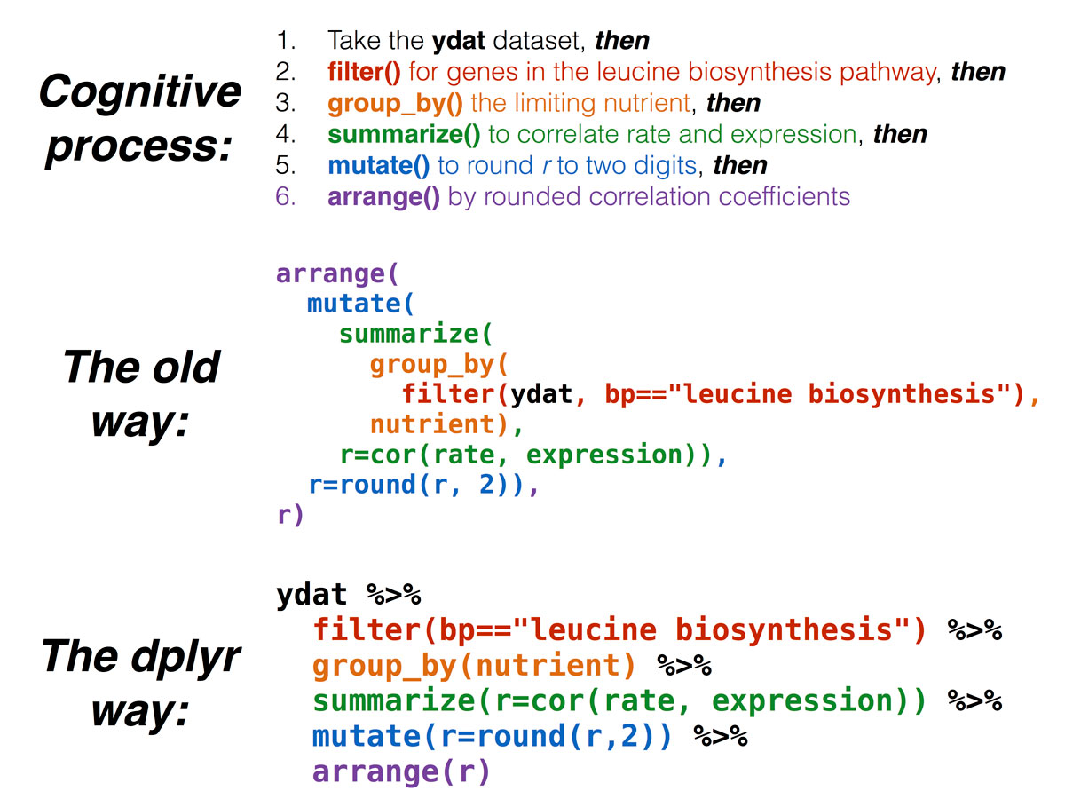
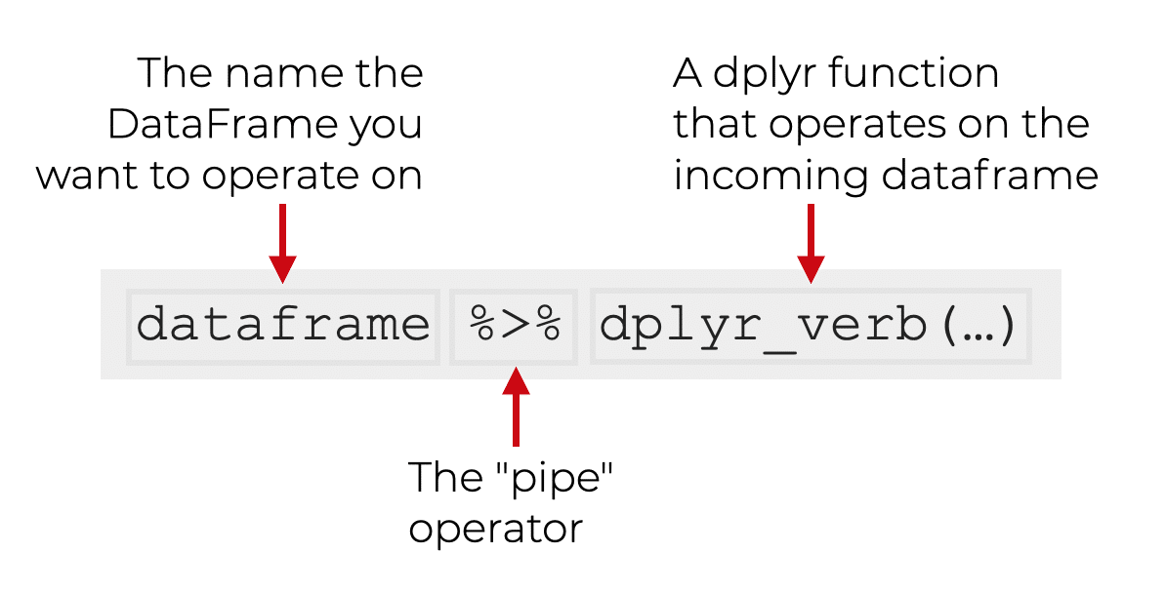
dplyr
Image: Sharp Sight & Bioconnector

Slide 29
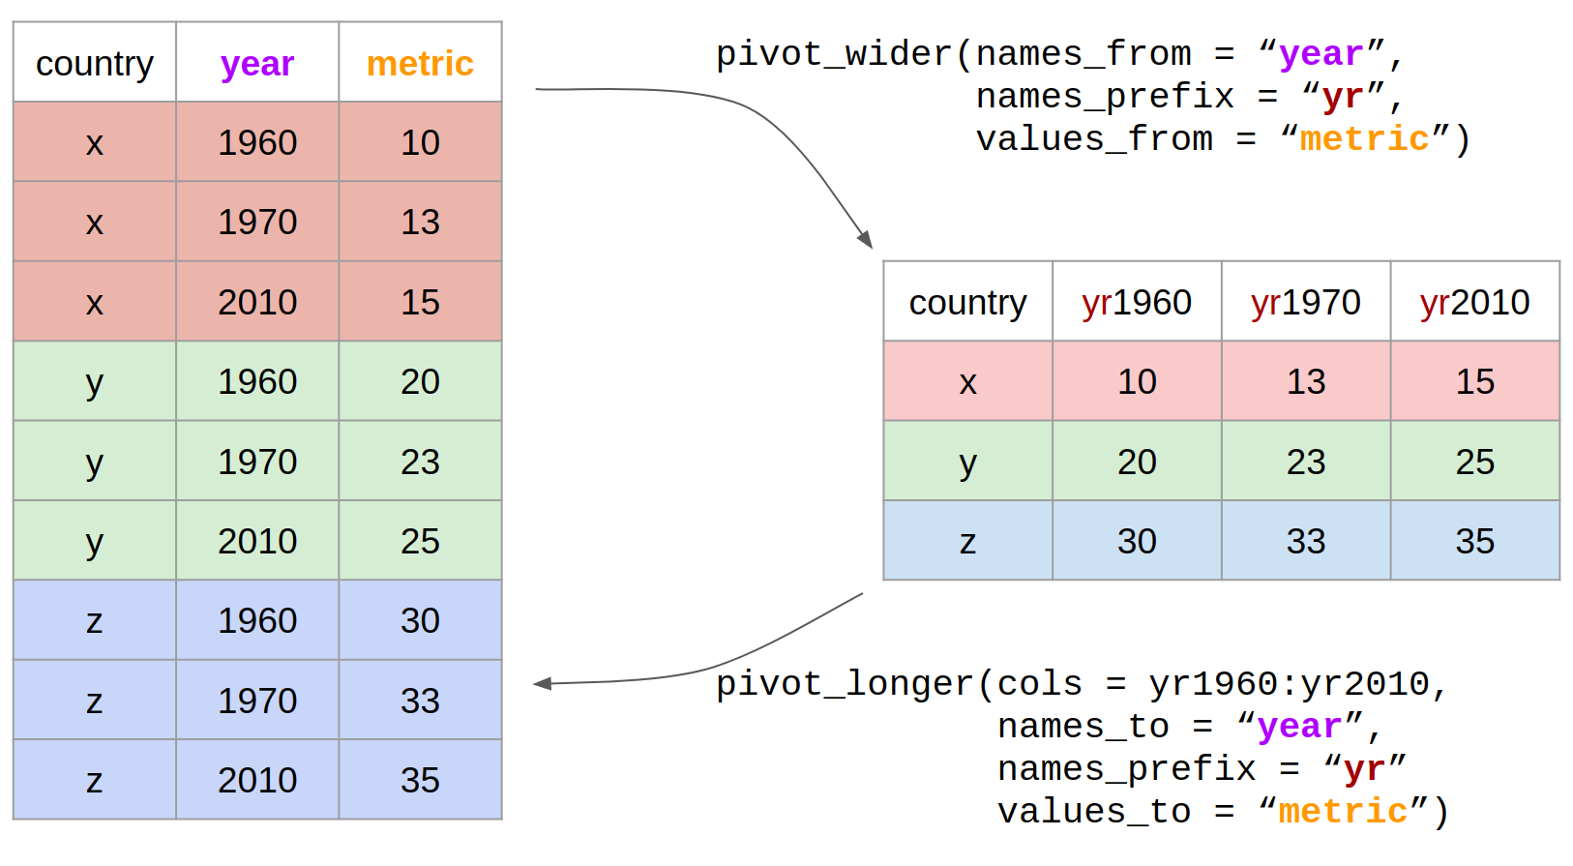
tidyr
Image: Hugo Tavares

Slide 30
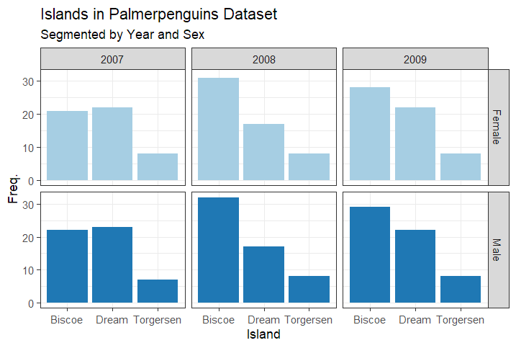
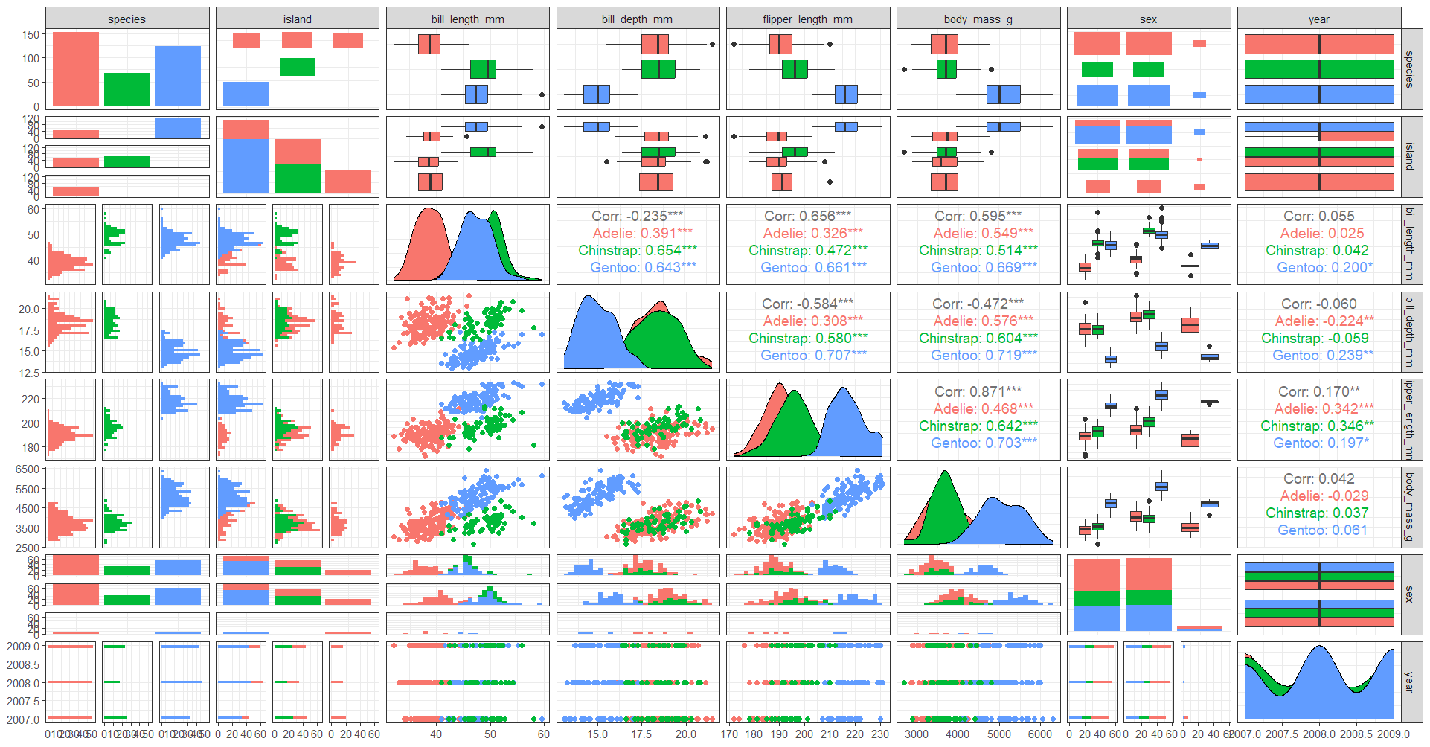
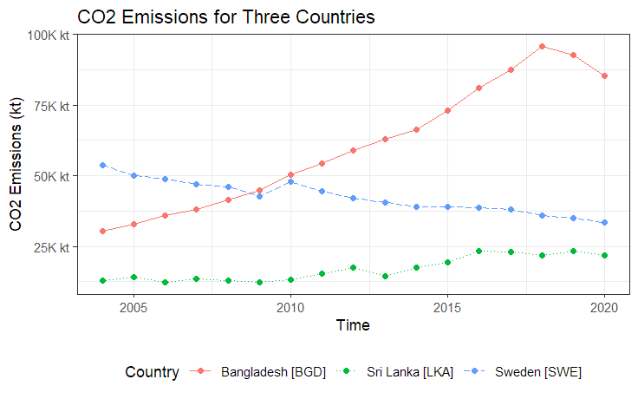
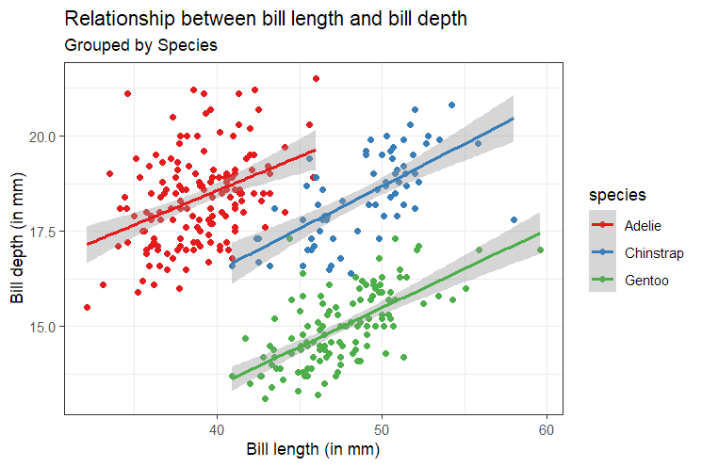
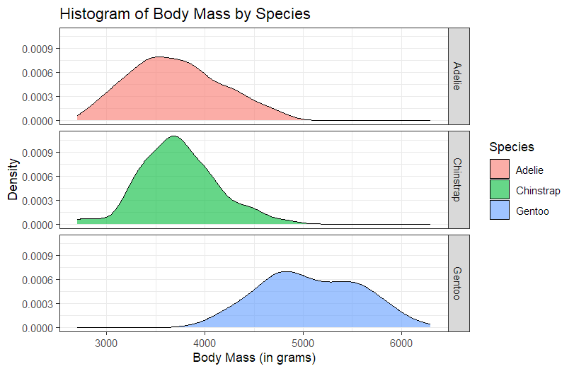
ggplot2

Slide 31
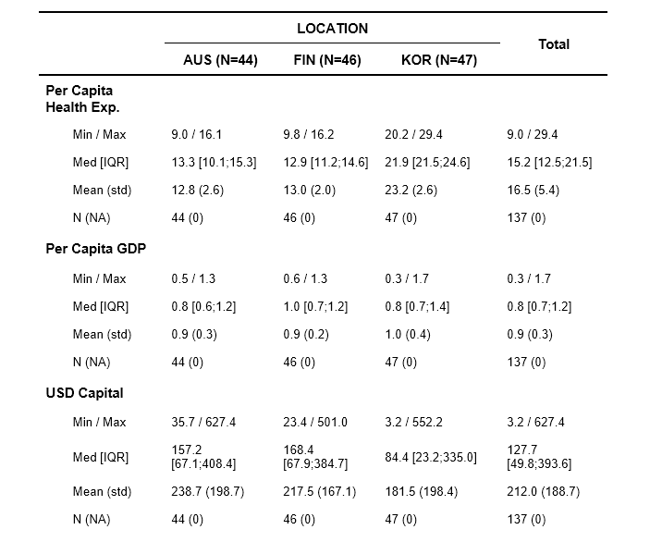
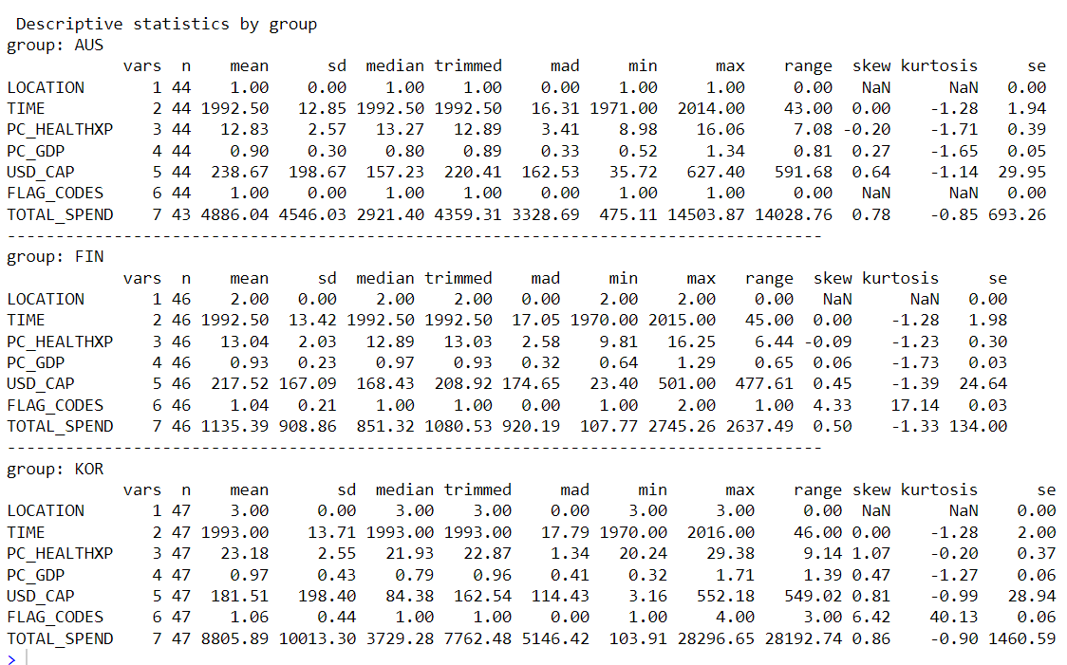
Summary Statistics

Slide 32
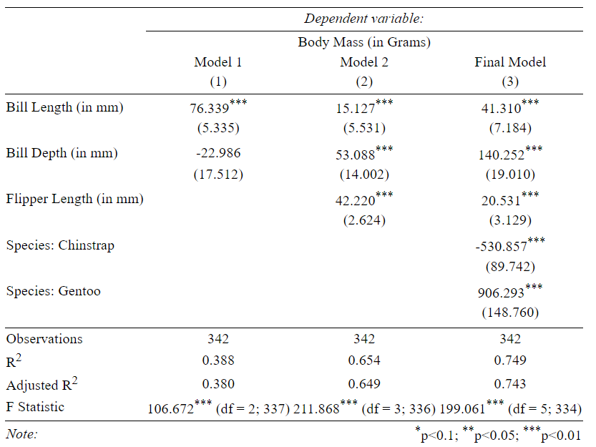
Statistical Model

Slide 33
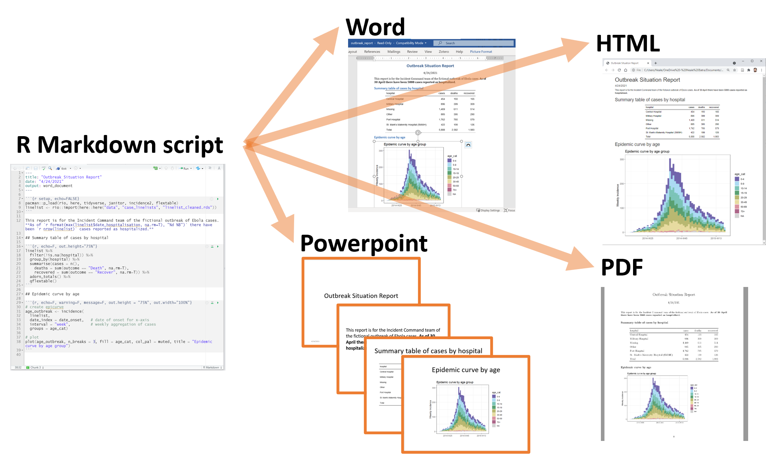
Reporting
Image: The Epidemiologist R Handbook

Slide 34

YOU CAN NOW START EXPLORING

